Slide 1
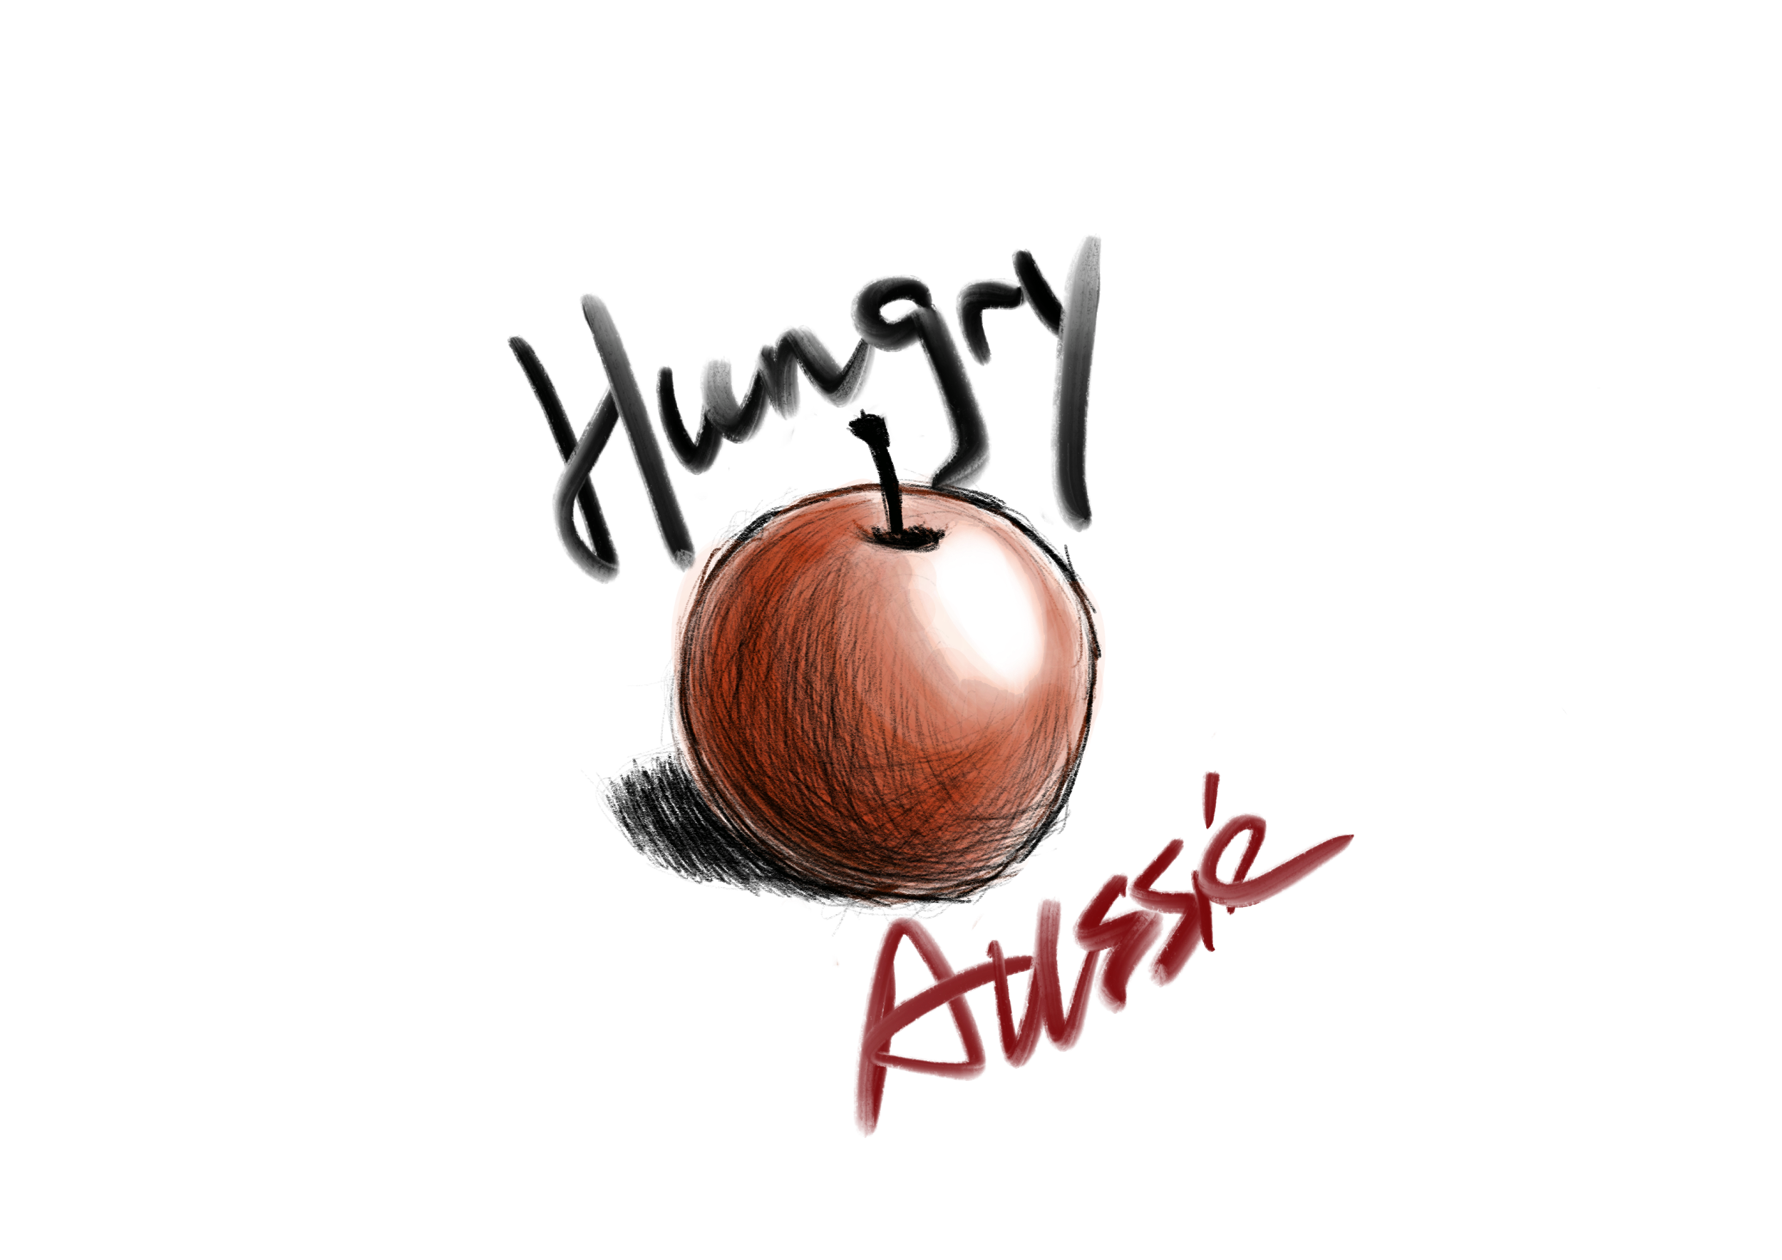
Hungry Aussie
A Restaurant Ordering & Management System
Jiaqi WU 480484095
Zelan XIANG 490150371
Hengfeng YAN 480517382
Xinpei CHEN 480215444

Slide 2

Content
Introduction
Design and Development
Deployment and Distribution

Slide 3
Introduction
manual recording
system recording
customers
staff

Slide 4
Significance
Primary User
Customers of the restaurant
Waiters/waitresses of the restaurant
Cashiers of the restaurant
Cooks of the restaurant
Manager of the restaurant
Owners of the restaurant

Slide 5
Content
Introduction
Design and Development
Deployment and Distribution

Slide 6
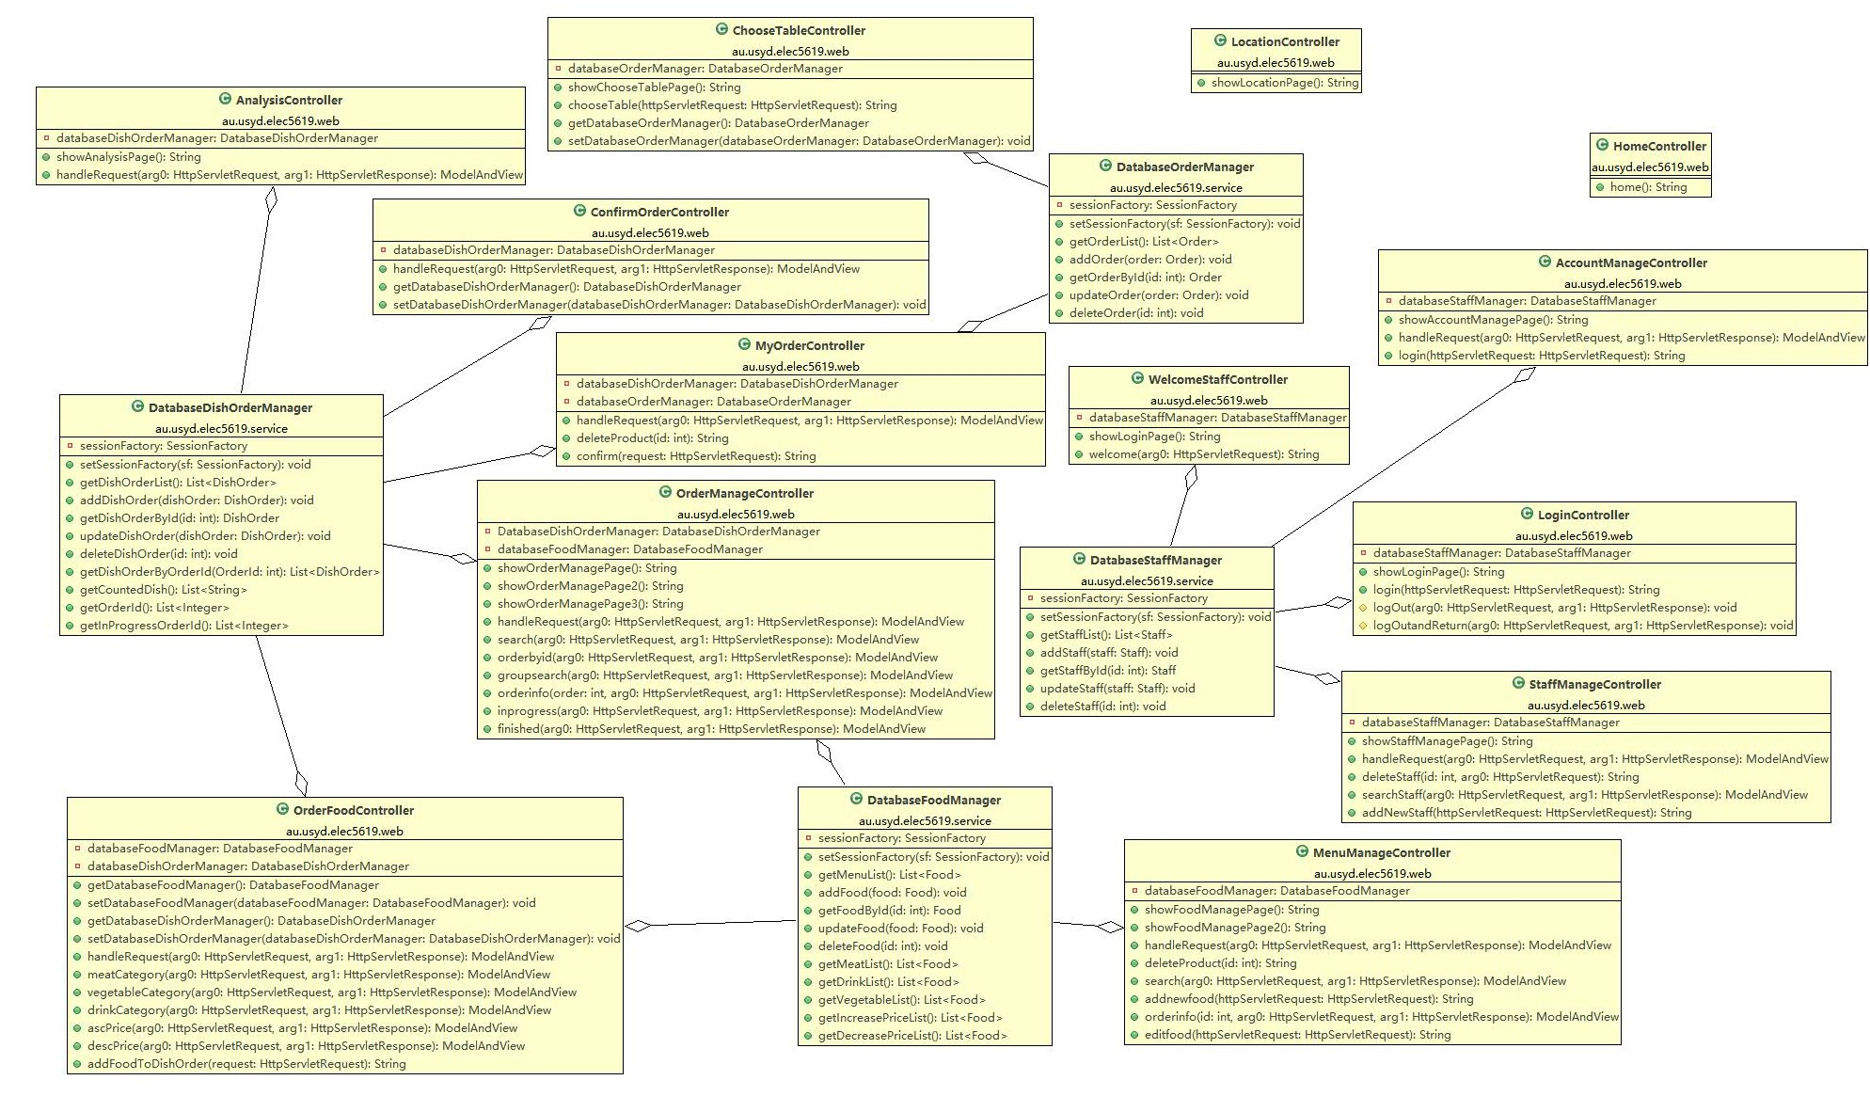
System Architecture
SpringMVC
Hibernate
MySQL

Slide 7
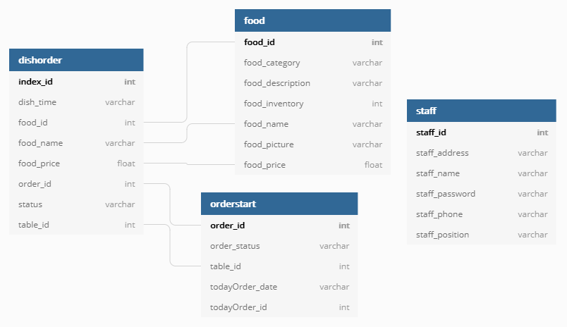
System Data Model

Slide 8
Design
The whole system comes with two parts:
Customer interface for restaurant’s customers, including following pages:
Table
Menu
My order
Location
Management interface for restaurant’s staff, including following pages:
Login
Welcome
Employee Management
Account Management
Menu Management
Order Management
Analysis

Slide 9
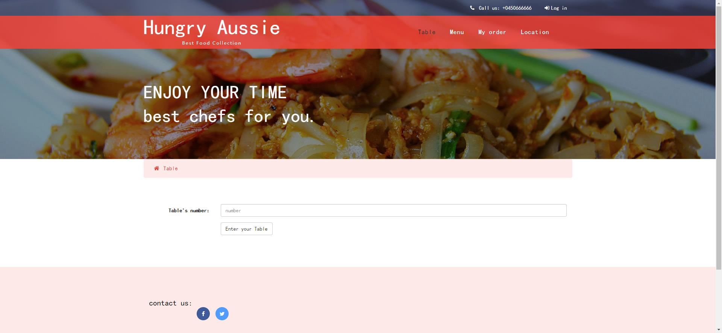
Customer interface

Slide 10
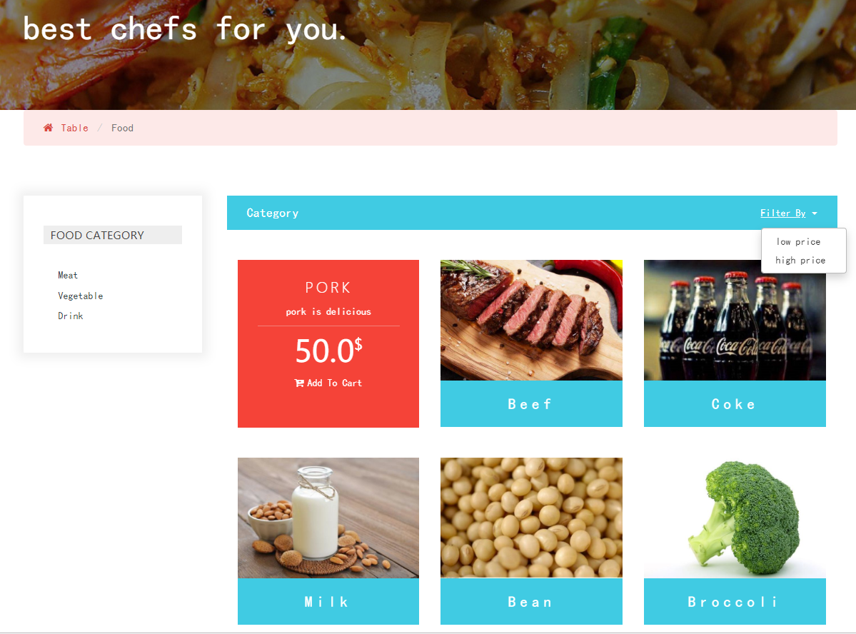
Customer interface

Slide 11
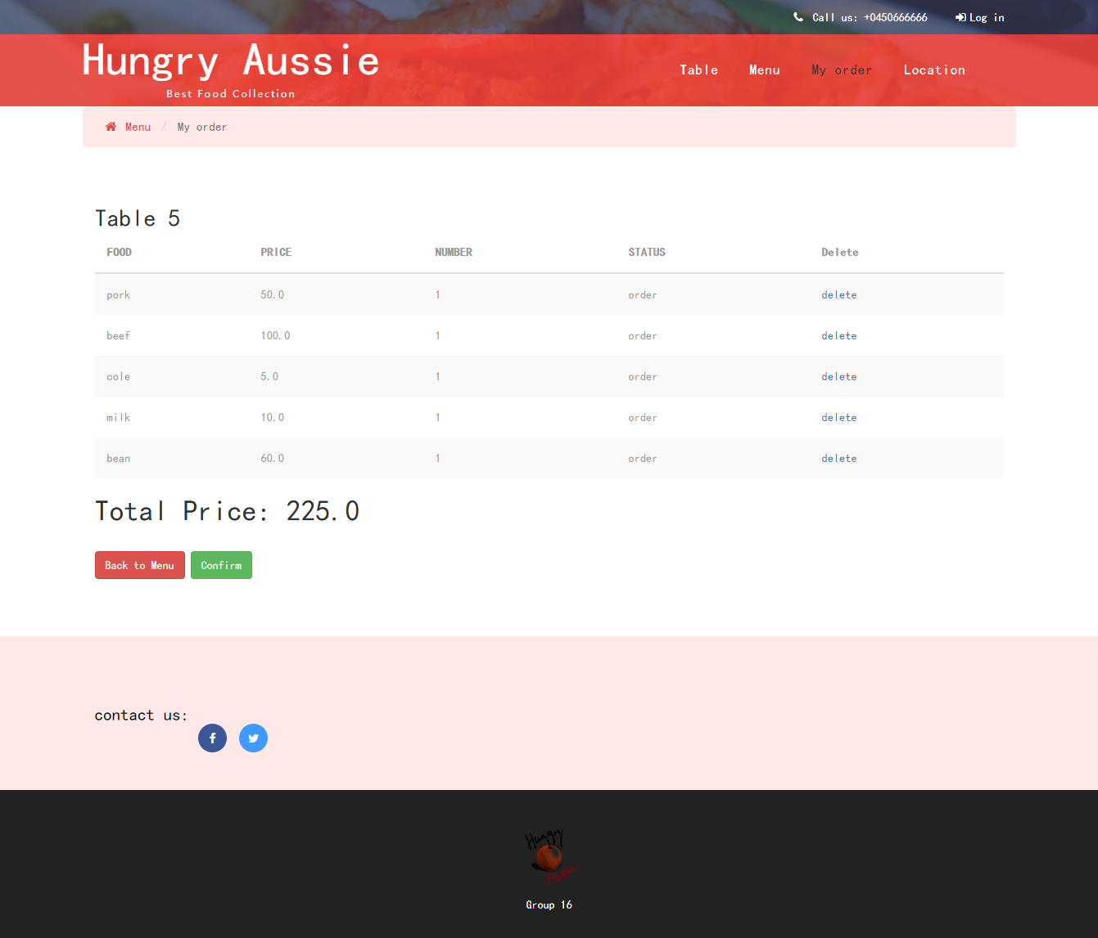
Customer interface

Slide 12
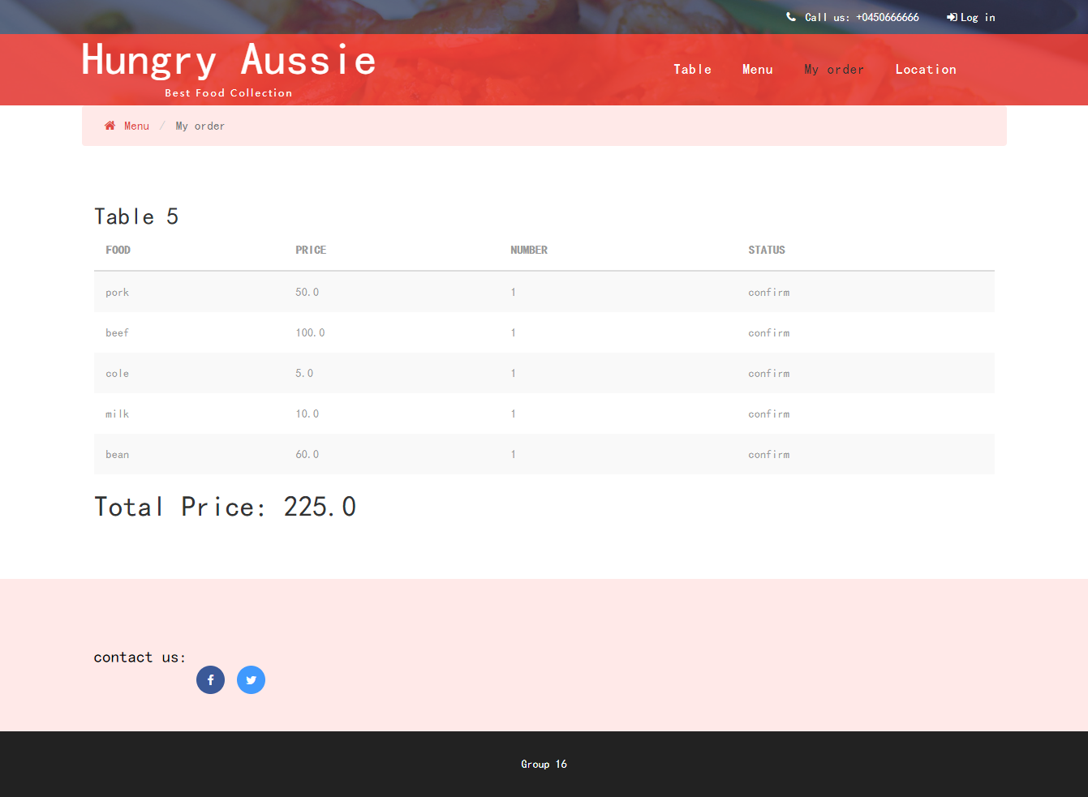
Customer interface

Slide 13
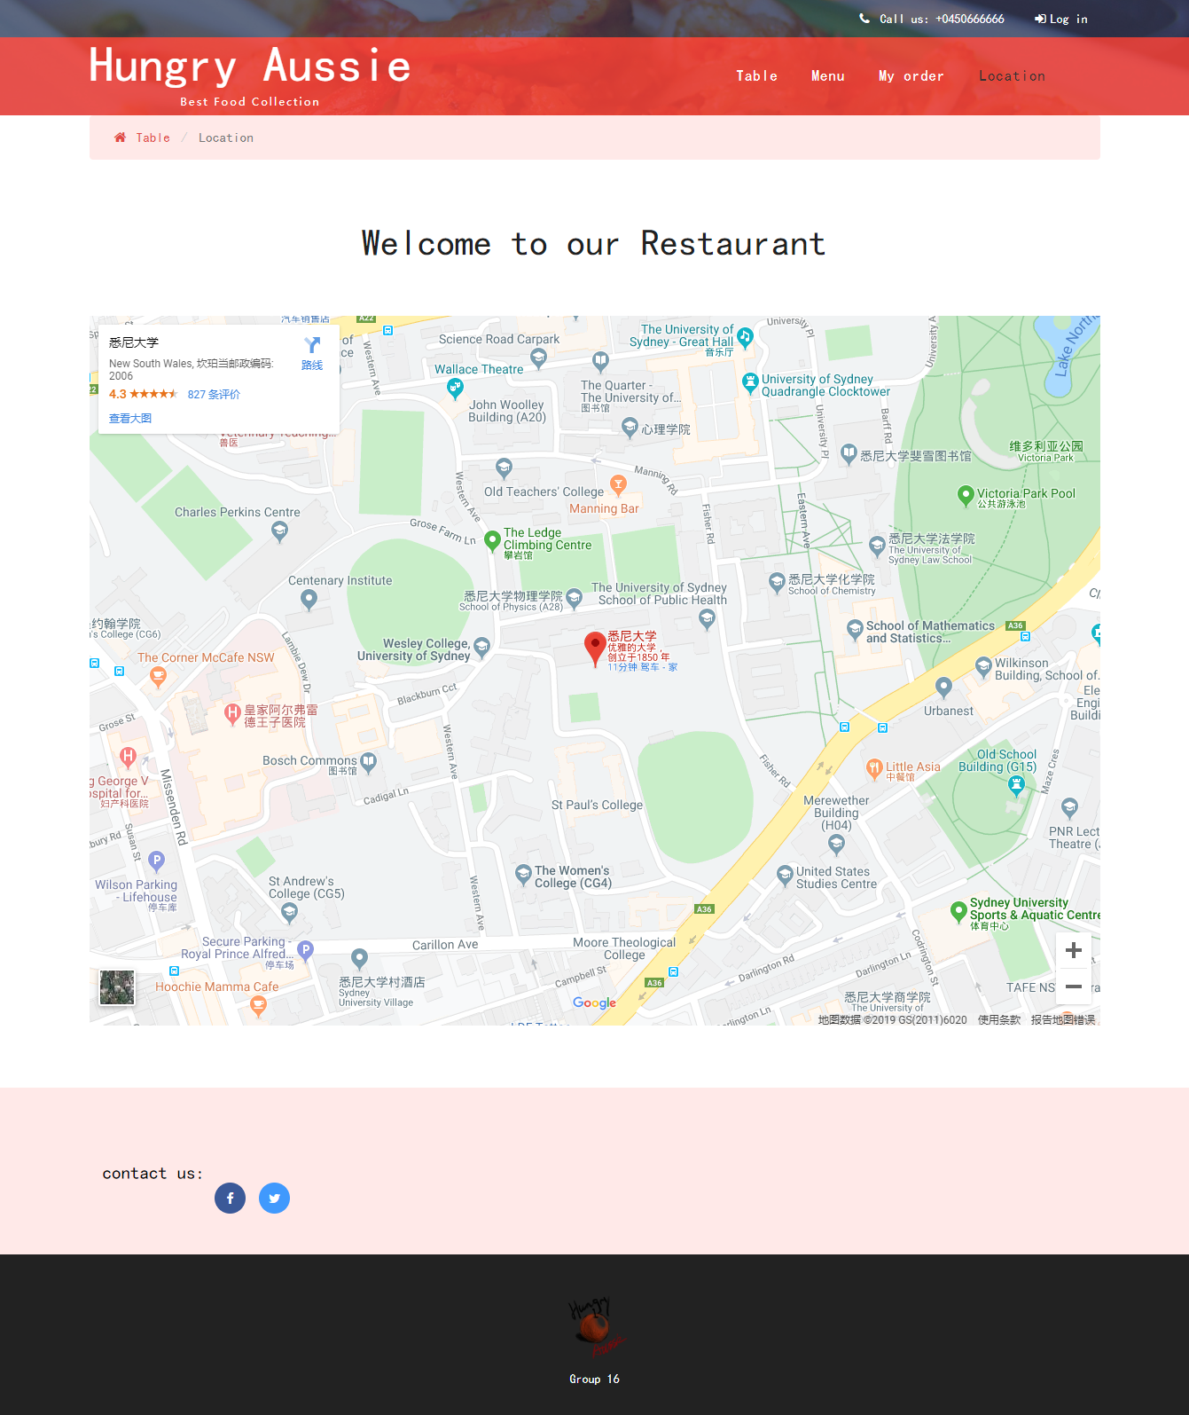
Customer interface

Slide 14
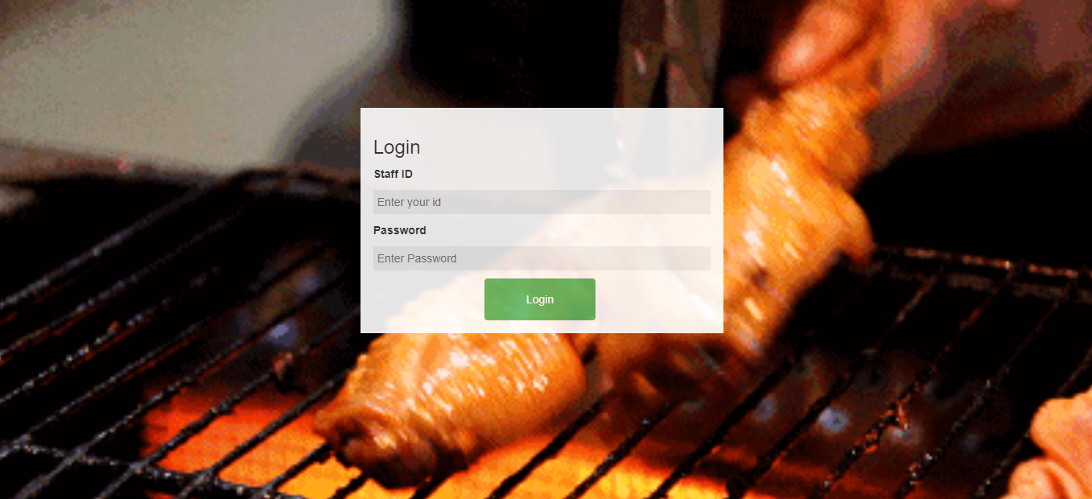
Management interface

Slide 15
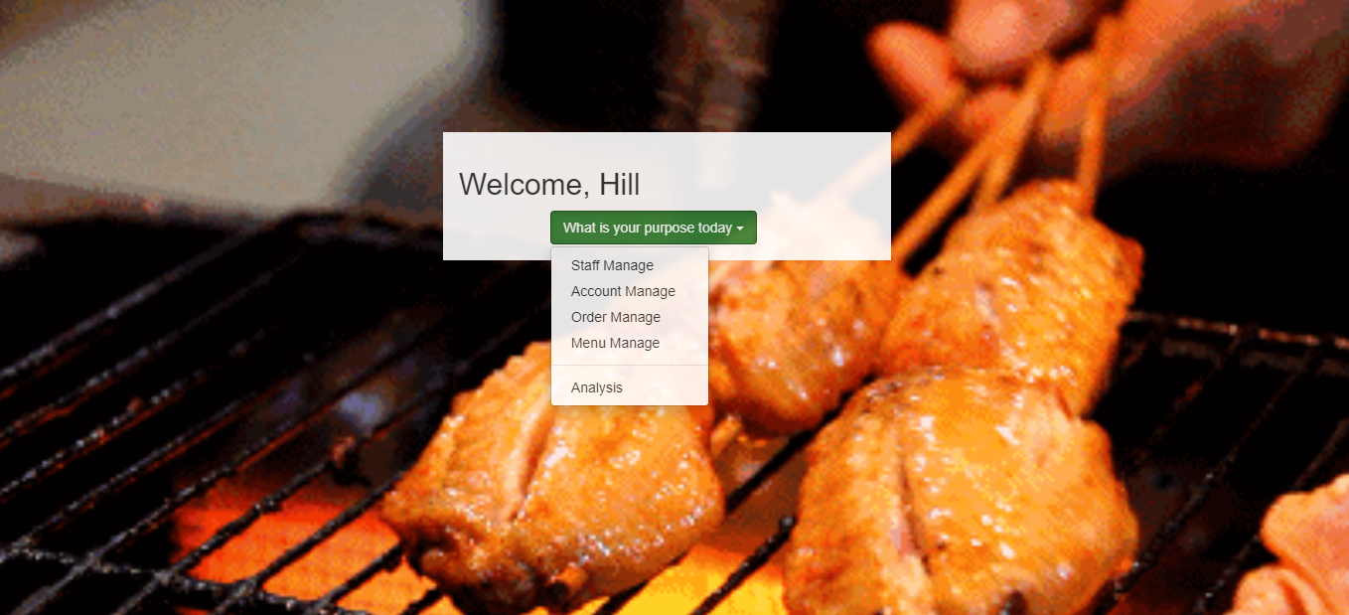
Management interface

Slide 16
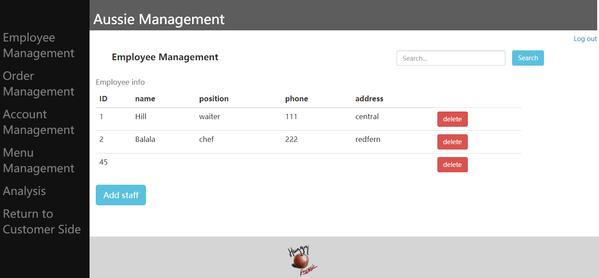
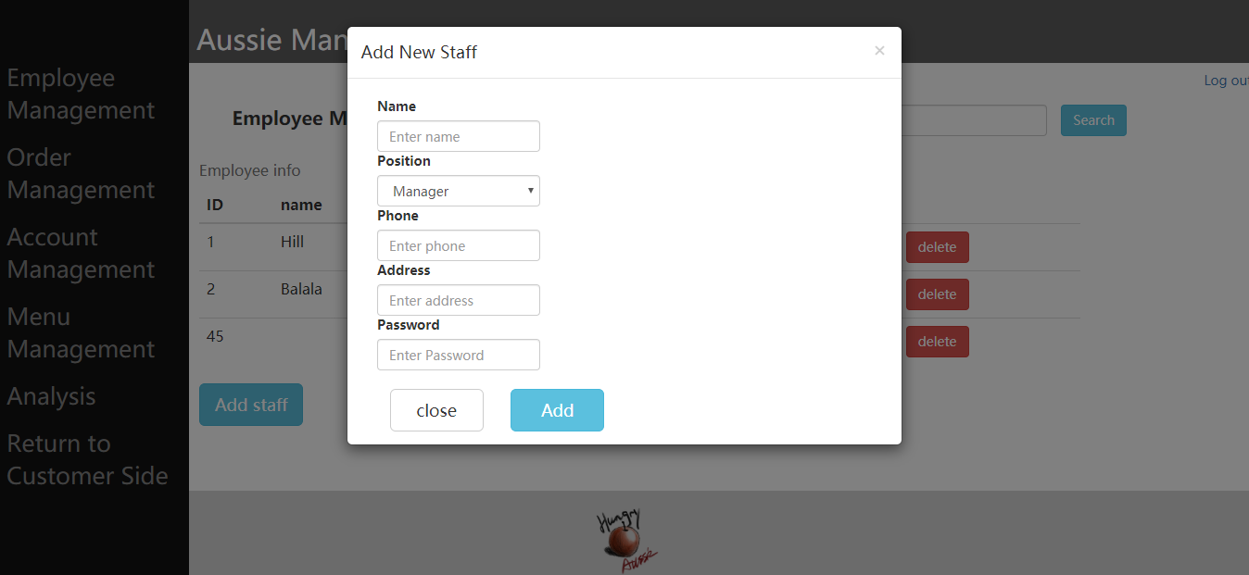
Management interface

Slide 17
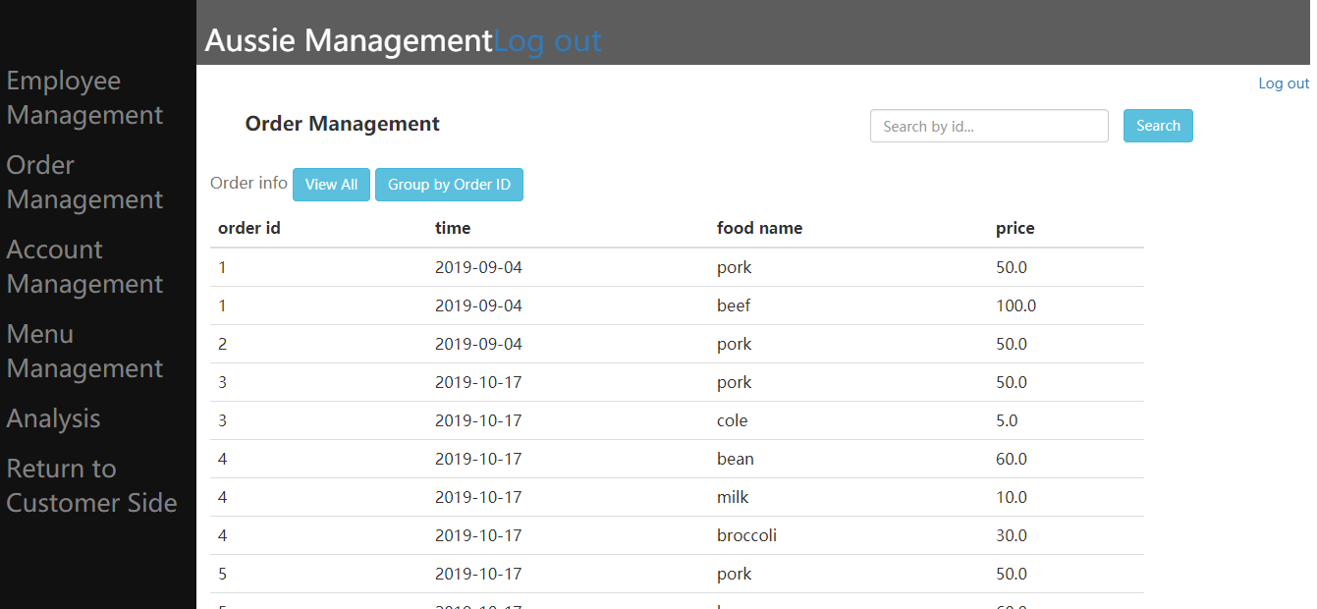
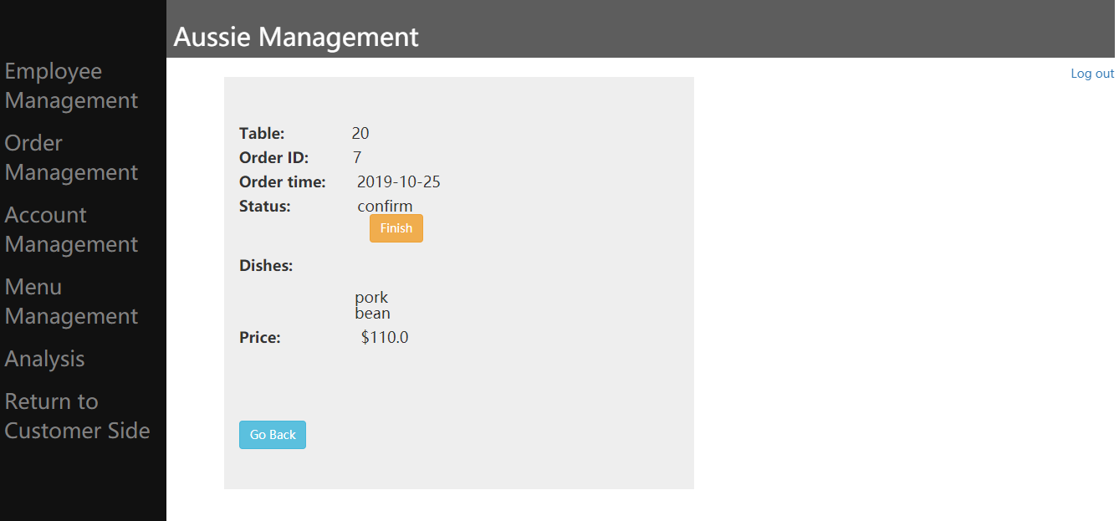
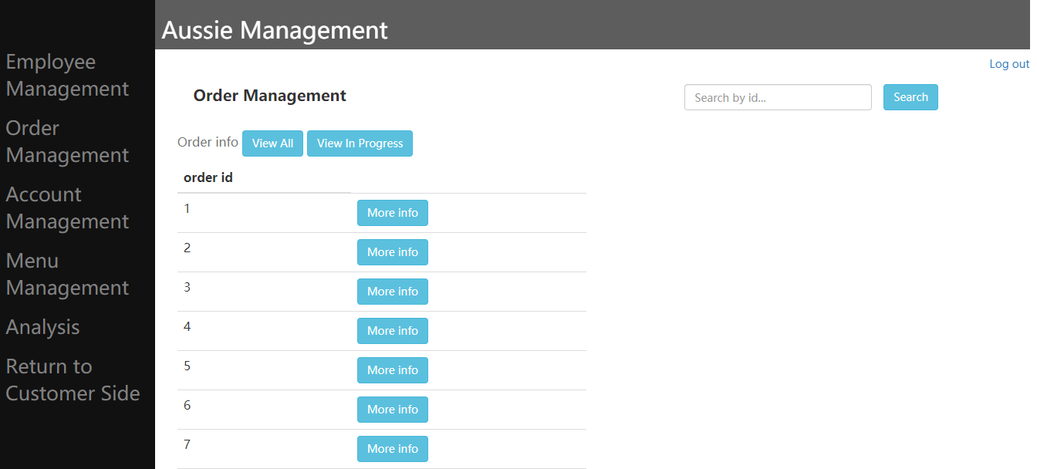
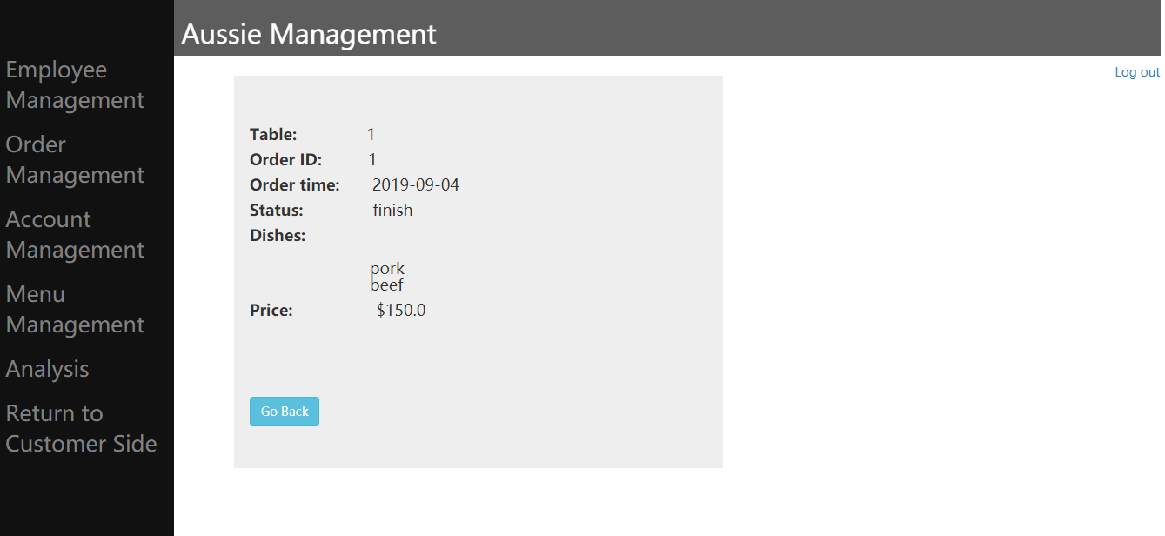
Management interface

Slide 18
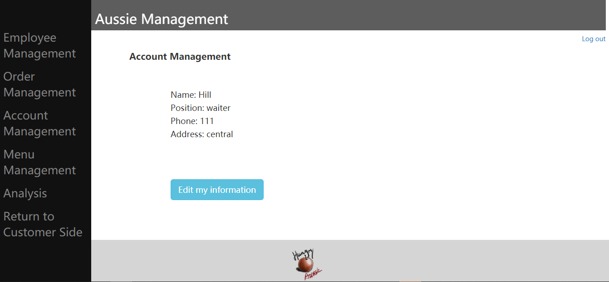
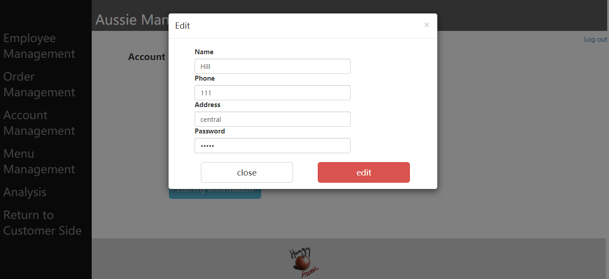
Management interface

Slide 19
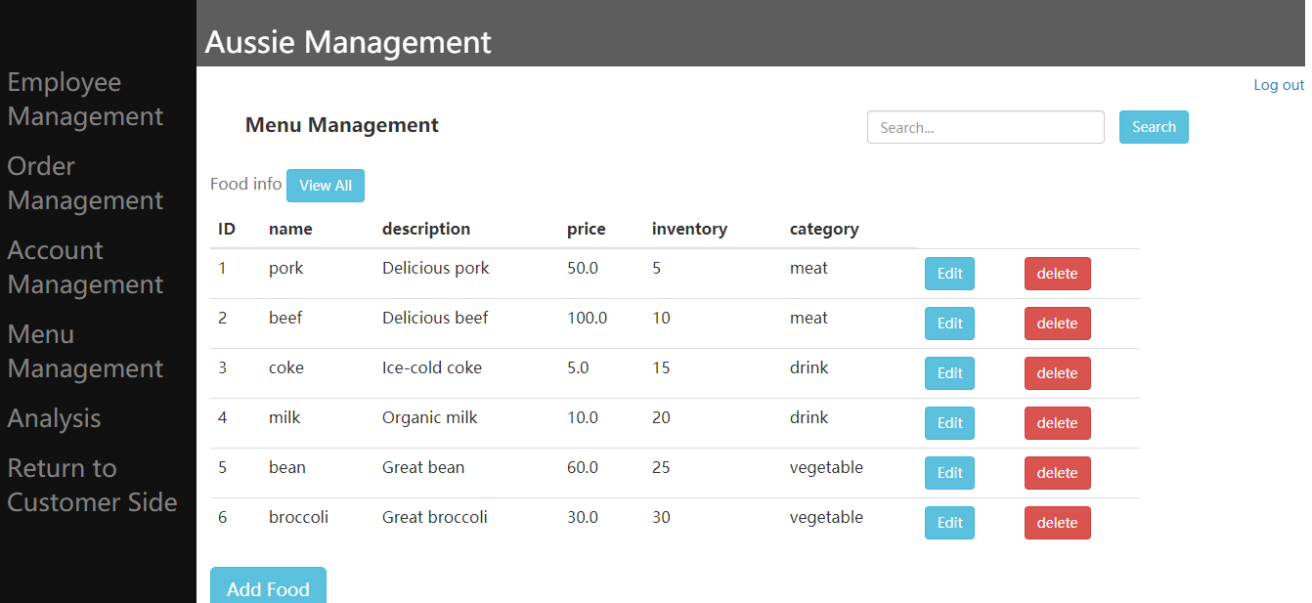

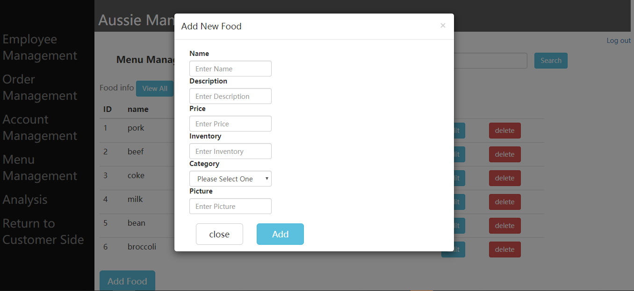
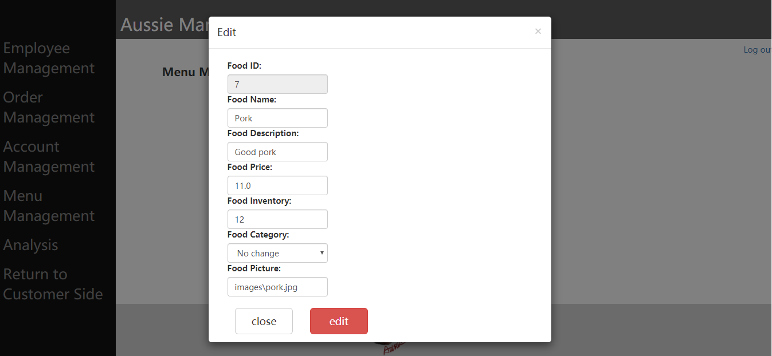
Management interface

Slide 20
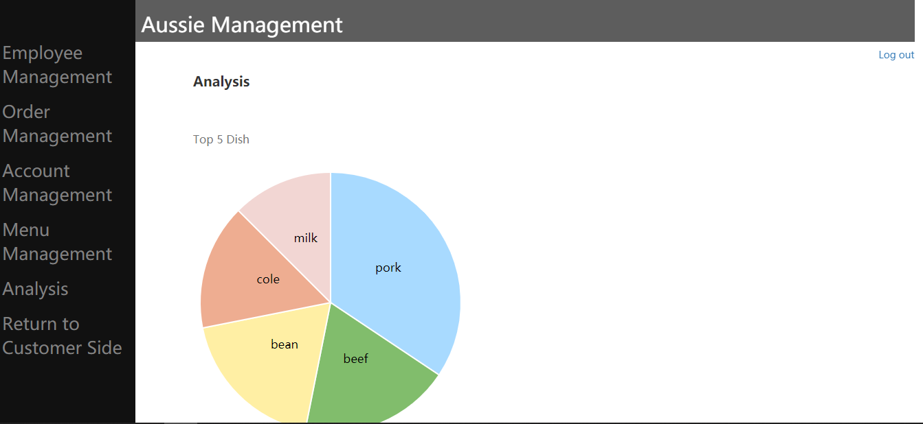
Management interface

Slide 21
Content
Introduction
Design and Development
Deployment and Distribution

Slide 22
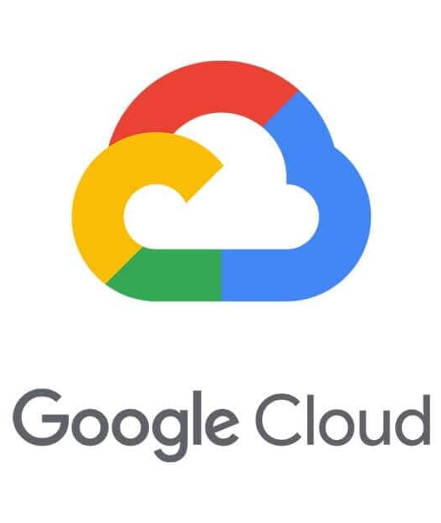
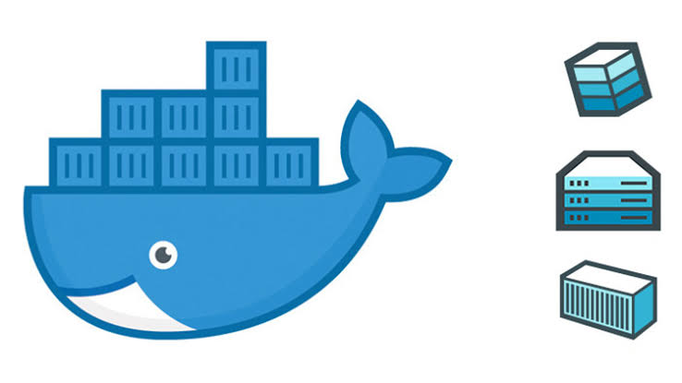
Deployment and Distribution
Dockerized
Google Cloud Platform Ready
PaaS and SaaS solution

Slide 23
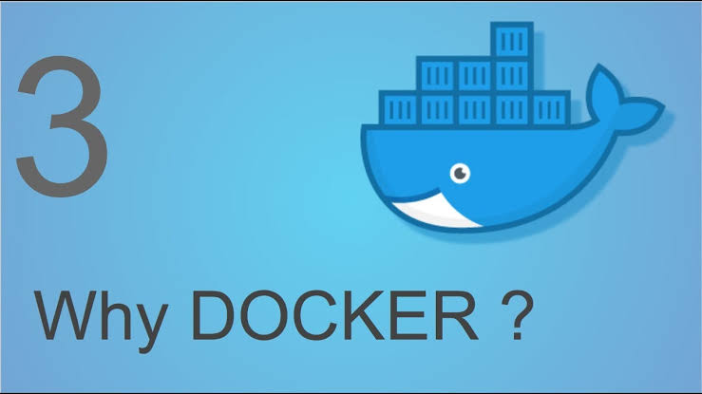

Slide 24
Why Docker?
Canned Solution: No need to worry about the enviornment!
High availability: One click to deploy!
High efficiency: Running multiple instances on a single machine!
High compatibility: Run any App anywhere!

Slide 25
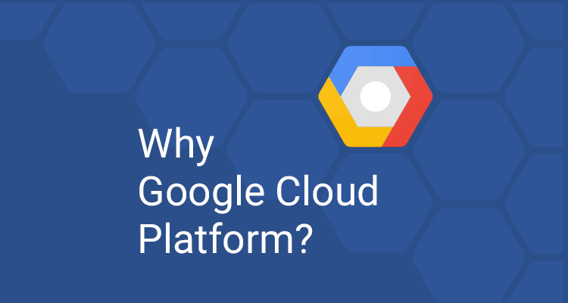

Slide 26
Why Google Cloud Platform?
Low cost: Start up a new product at $0!
Worldwide nodes: Speed up your business on a global scale!
Easy to use: Everyone knows a little Linux can handle with ease!
High reliability: Top cloud computing provider with top level reliability!
Flexible scalability: Easy to scale up or down depend on your business!

Slide 27
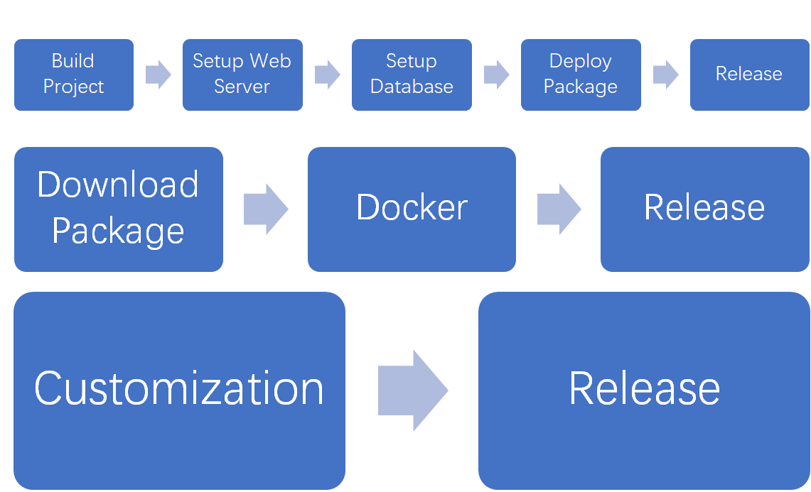
Simplified Deployment and Distribution Process
Traditional Model
PaaS Model
SaaS Model

Slide 28
Next...
Improvement
Optimization
And more...

Slide 29
Thank you

